Slide 1

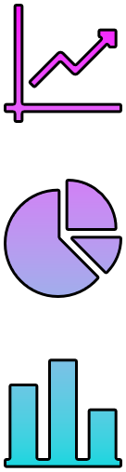


DATA Visualization

Slide 2

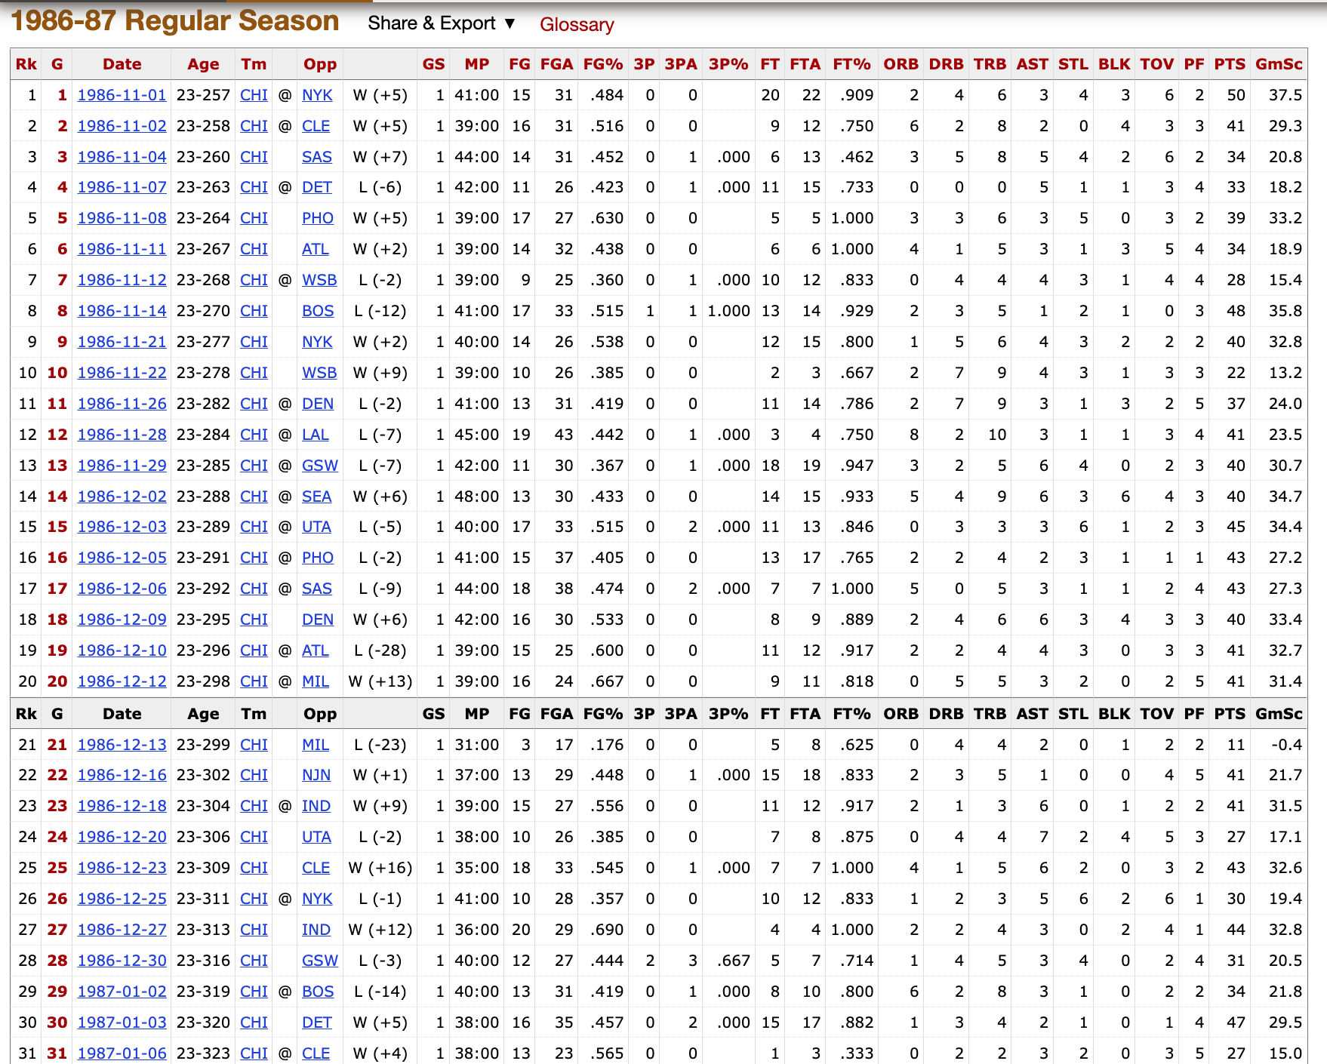
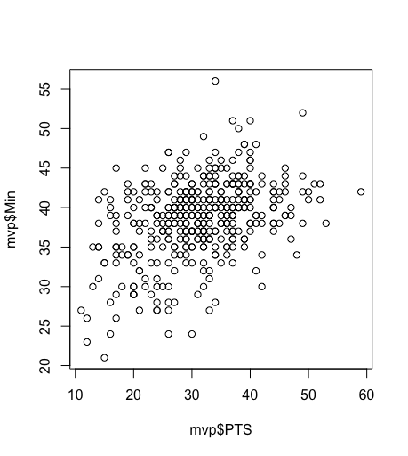
DATA Visualization
Data viz is simply how we graphically represent data
It is an all-encompassing term for charts, graphs, & figures (midway, 2020)
Basketball-reference.com
Notes:
The motivation behind placing an emphasis on Data Viz is to enhance scientific communication skills by representing data in interpretable ways that may be more accessible than pouring through the data on its own. Think how much we have relied on graphs and charts during the pandemic.
We can go from a table with many different variables to representing interesting relationships amongst the data.
It helps look at very large and very minute timescales to detect any patterns, relationships, effects, etc. that we may not intuit from the data upon initially inspecting it.

Slide 3
THE Grammar of graphics
(WILKINSON, 1999)
THEME
DATA
COORDINATES
AESTHETICS
STATISTICAL
TRANSFORMATIONS
GEOMETRIC
OBJECTS
FACETS
Notes:
The Grammar of Graphics is not exclusive to ggplot2, but it is what ggplot2 is based on, hence the “gg”. The Grammar of Graphics was developed by Leland Wilkinson as a foundation for producing nearly every type of graph imaginable.
We will be specifically tinkering with some of these aspects today, but I wanted to provide you all the foundation of the language used in ggplot before we dive in.
So, what is ggplot?

Slide 4
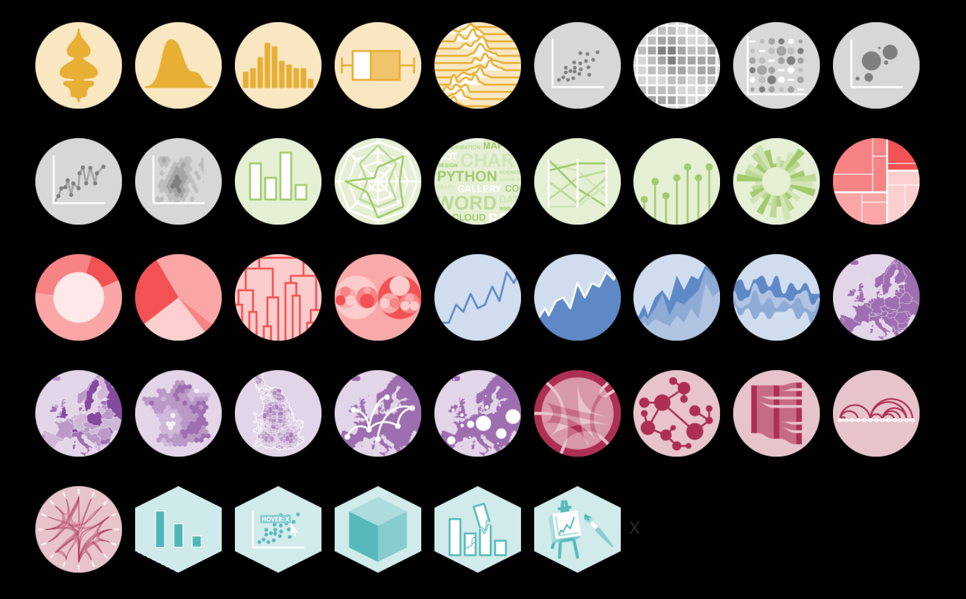
Ggplot2
This is a package in the tidyverse that creates graphics for your data in R. (https://ggplot2.tidyverse.org/)
It is highly customizable and provides more options than the native R plot function
r-graph-gallery.com
Notes:
The native R plot function can achieve many of the graphics that we will see today, but it is not as intuitive, and the community for ggplot and the Grammar of Graphics is large and supportive.
What kind of charts can we work with? Well…
Violin, density, bar chart, scatterplot, line graphs, pie charts, ridgeline graphs, heat maps, animated graphs and so many more.
r-graph-gallery.com

Slide 5
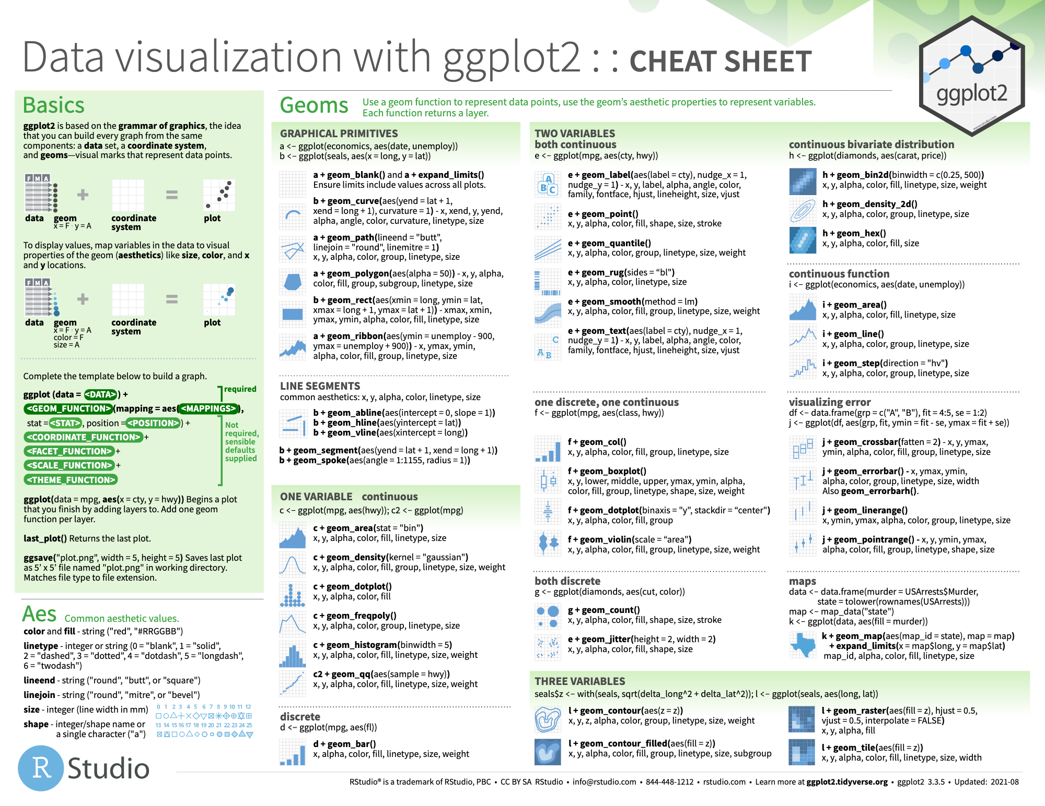
cheat sheet
Exercises
grobs
grobs
grobs
grobs
grobs
grobs
Notes:
Basing ggplot off of the Grammar of Graphics keeps everything within the same system so you aren’t piecemealing different packages and functions together. You are also able to save the plots as objects, which are called Grobs, and we will be using these today.
The cool thing about ggplot’s customization is that you are essentially just adding layers and arranging them as you need them. I have included a basic cheat sheet that is available on the ggplot section of the tidyverse site.
Each type of graph can address each of the different elements in the grammar of graphics language that makes ggplot’s visualization easy to work with. If anyone has worked in Photoshop or even rearranged objects in PowerPoint, then you already have a basic understanding of how layering works.
We’ll see more intricate examples in our exercises!

